Slide 1

NBAC Annual Meeting 2020 NIEM 2021 Priority Planning 18 September 2020
Katherine Escobar

Slide 2
Executive Focus
Promote Adoption and Growth
Registry/Repository – Re-use
Tools aligned with NIEM Lifecycle
Improve current, but look to the future
Review/ Improve Processes
Consolidate, Streamline & Publish
Encourage Greater State, Local & Tribal Participation
Keep Focus on Emerging Technologies
Move Toward Model Maturity
Improve Business Model Processes/Practices
Governance
Outreach
Standard Practices
Embrace Internationalization
Continue to Aggressively Pursue “Virtual” and Live Engagement Opportunities

Slide 3
NBAC “Virtual” Annual Meeting
Purpose
Provide NBAC and NIEM leadership with a snapshot of 2020 selected topics to help define the issues and Work Plan for 2021.
Key Topics
NIEM Adoption, Growth and Implementation
Tiger Team status, progress
Work Plan – NTAC/NBAC Collaboration
Priorities
Building Blocks to 2021 Work Plan

Slide 4
NBAC Annual Meeting SESSION schedule
Session Date & Time |  | Session Topic | Planned Speakers | Facilitators
1 | Monday, 14 Sept 10 a.m. – Noon EDT | Advancing NIEM Adoption | Kshemendra Paul NIEM Executive Steering Council | Kamran Atri Thomas Krul
2 | Monday, 14 Sept 1 – 3 p.m. EDT | State, Local, Tribal Tiger Team | Eric Sweden National Association of State Chief Information Officers (NASCIO) | Cait Ryan, Tom Carlson Thomas Krul
3 | Tuesday, 15 Sept 10 a.m. – Noon EDT | Supporting Domain Growth | Brian Gattoni DHS CISA CTO | Kamran Atri Thomas Krul
4 | Tuesday, 15 Sept 1 – 3 p.m. EDT | Emerging Technologies Tiger Team | Syed Mohammed Director, US Department of Homeland Security, Modeling and Simulation Technology Center | Jalal Mapar Lain McNeill
5 | Wednesday, 16 Sept 10 a.m. – Noon EDT | Improving NIEM Implementation | Jon Kirk, Patrick Lagioia Treasury Board of Canada | Thomas Krul Kamran Atri
6 | Wednesday, 16 Sept 1 - 3 p.m. EDT | International Tiger Team | Poewan Lau | Thomas Krul Kamran Atri
7 | Thursday, 17 Sept 10 a.m. – Noon EDT | NIEM Release Planning | Working Session | Christina Medlin Web Roberts
8 | Thursday, 17 Sept 1 - 3 p.m. EDT | NBAC/NTAC Collaboration Planning | Working Session | Kamran Atri , Webb Roberts Thomas Krul, Scott Renner
9 | Friday, 18 Sept 10 a.m. – Noon EDT | NIEM 2021 Priority Planning | Stuart Whitehead NIEM Executive Director | Katherine Escobar Stephen Sullivan
10 | Friday, 18 Sept 12 -12:15 p.m. | Annual Meeting 2020 Wrap-up |  | Kamran Atri Thomas Krul Stephen Sullivan

Slide 5
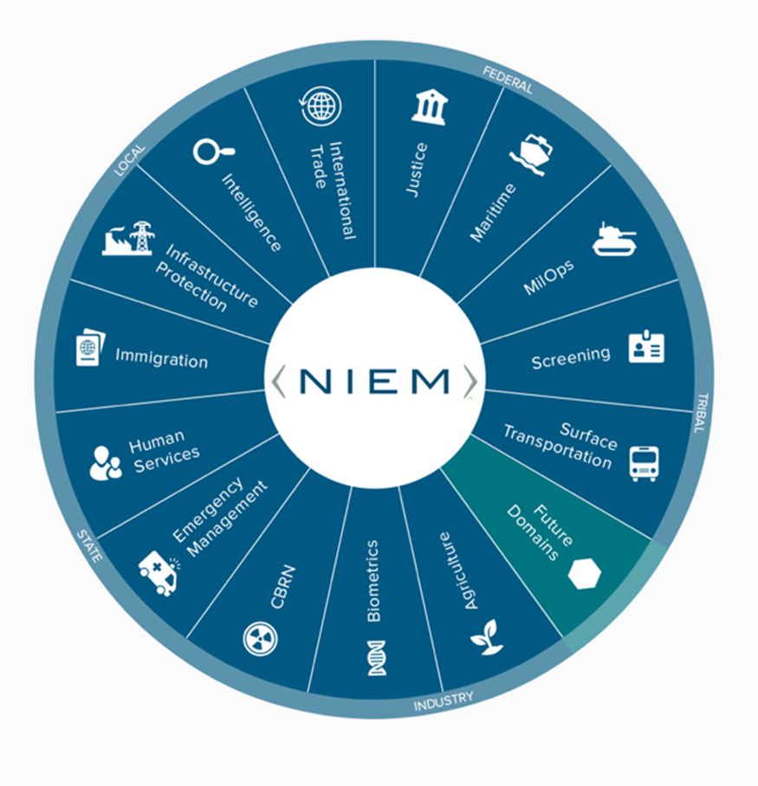
current - NIEM Domains and Adoptions
Domains | STEWARD/Organization
Agriculture | VACANT, Garon Reeves/ USDA OCIO
Biometrics | John Boyd, Satish Sripada, Jennifer Stathakis, William Graves, Diane Stephens/ DHS OBM, DHS OBIM, FBI, DoD PM BIO, NIST
CBRN | Brendon Plapp/ DHS
CYBER – NEW FY 20 | Brian Gattoni, Preston Werntz, Juan Gonzales/ DHS CISA
Emergency Management | Dan Cotter, Kamran Atri/ DHS, A4SAFE-DHS
Human Services | Tom Carlson, Dorothy Wan/ HHS AFC
Immigration | Curtis Ross, Jennifer Kish/ DHS USCIS
Infrastructure Protection | Preston Wertz, Juan Gonzales/ DHD CISA
Intelligence | Sue Dorr/ ODNI
International trade | Thomas Mills, Shailesh Sardesai DHS CBP
Justice | Kate Stilhol/ Nlets
Maritime | Sandra Brown, Kelly McCool/ OPNAV N9ID, N2N6IB
MilOps | Jeffery R. Jones, Ralph O’Connell/ JS J6
Screening | Steve Yonkers/ DHS
Surface Transportation | Dan Morgan/ DOT
ONBOARDING | STEWARD/Organization
Statistics | TBD, Chris Carrino/ Census Bureau

Slide 6
potential - NIEM Domains and Adoptions
Domains | Organization/POC
Health | Health and Human Services/ TBD
METOC/NOAA | National Oceanic an Atmospheric Administration /Kevin Jackson/
Logistics | US Transportation Command / James Decarli
Humanitarians Aid | US Agency for International Development/ Brandon Pustejovsky
Bureau of Reclamation | US Department of the Interior/Andrew Marquat
General Administrative Services | Treasury, Office of Management and Budget, General Services Administration
Military Service Member | Veteran Affair/ Kshemendra Pau
Education | TBD
ADOPTIONS | Purpose
Department of Education | Create IEPDs, exchanges
FEMA Grants | Explore establishing common vocabulary
FEMA Food Insurance & Mitigation ADM (FIMA) | Learning more about NIEM, exchanging training materials & exploring initial use case and value proposition
NOAA Fisheries | Learning more about NIEM, exchanging training materials & exploring initial use case and value proposition
Treasury Department (DAIMS) | Learning more about NIEM, exchanging training materials & exploring initial use case and value proposition

Slide 7
Prelude - NTAC OUTBRIEF to NBAC
Thursday, 27 August Session: 1 -3 p.m.-EDT
Topics
NIEM 5.0 Status
NIEM Message Specification 1.0 Rules and Conventions
Tools
NIEM Models
Other Topics
NTAC-NBAC Interactions
Facilitators: NTAC & NBAC Co-Chairs

Slide 8
NIEM 5.0 Major release
Notes
NIEM 5.0 is a major release and will include updates to Core, specifications, and tools
Check release status at https://niem.github.io/niem-releases/
Adding new schema-level attribute xml:lang for future internationalization support
Will update GENC from 3.10 to 3.11
Draft JSON spec version 4 beta 1 available for review at https://github.com/NIEM/NIEM-JSON-Spec/releases/tag/v4.0beta1
Phase | NIEM
Alpha 1 | March 2020
Beta 1 | June 2020
RC 1 | August 2020
Release | Fall 2020
MOMS | Q1 2021
Content Changes from four domains:
Incorporate Controlled Unclassified Information (CUI) information exchanges (DoDI 5200.48 supersedes FOUO policy
CDC public health emergency operations center (PH-EOC) content
Generic Statistical Information Model (GSIM)
NIEM JSON Conformance Specification
Resolved 57 harmonization and technical issues
Notes:
Harmonization and QA
NIEM Harmonization Workgroup meeting regularly to discuss harmonization and QA issues affecting Core, multiple domains, and domains without active representation.
Main issue tracker at https://github.com/NIEM/NIEM-Releases/projects/3
Assigned issues at https://github.com/NIEM/NIEM-Releases/projects/4
Participation welcome! Email christina.medlin@gtri.gatech.edu for more.

Slide 9
NBAC Annual meeting 2020
Friday, 18 September Session Nine: 10 a.m.-Noon EDT
NIEM 2021 Priority Planning
Speaker: Stuart Whitehead, SES
Deputy Director Cyber & C4 Integration, Joint Chiefs of Staff J6 NIEM Executive Director
Facilitators: Katherine Escobar, Deputy Division Chief Data & Services Division & NIEM Managing Director Steve Sullivan, NBAC Secretariat

Slide 10
Remainder of CY2020 Work plan
Major Goals
Complete NIEM 5.0 major model update and initiate NIEM 5.1 minor
Conduct a robust strategic communications engagement
Emphasize integration with emerging technologies – Meta Model (AI, Cloud, Cyber, UML, JSON)
Mature international alignment (Canada, FVEY, NATO)
Two domains in the offing: Statistics, Health
Lay foundation for a strong 2020/2021 state, local, tribal engagement

Slide 11
FY2020 DOD NIEM Successes
NIEM 4.2 Minor Release (Nov 2019)
NIEM 5.0 Major Release (SEP 20) and initiate 5.1 minor
MIL-STD-6040 US Message Text Format (USMTF) NIEM conversion to NIEM (60% complete)
Link 16 XML instantiation guidance – need wording
Defense Counterintelligence and Security Agency (DCSA) DoD Contract Security Classification Specification content into MilOps 4.2 (Dist C/D)
NATO Core Data Framework (NCDF) Datalake (NIEM in NATO)
Federated Mission Network (FMN) Spiral 4 Specification Package (Apr)
Adopted as FVEY Combined Communication-Electronics Board objective - n
NATO Alliance Future Surveillance and Control (AFSC) program adoption
Conduct a robust strategic communications engagement
NATO Core Data Framework (NCDF) = NIEM
Notes:
Defense Counterintelligence and Security Agency (DCSA) DoD Contract Security Classification - NIEM conformant DD 254 document Automated via NIEM saving time and money

Slide 12
FY2020 DOD NIEM Successes Cont.
IEPD Registry/Repository completed requirements analysis and development start
IEPD Development Tools completed requirements analysis and development start
Implementation of baseline Meta-model transitioning NIEM to language agnostic vs. XML
Defense Acquisition University development of Program Management course (Oct. 1 Launch)
Emphasize integration with emerging technologies – Meta Model (AI, Cloud, Cyber, JSON)
Mature international alignment (Canada, FVEY, NATO)
Two domains in the offing: Statistics, Health
Lay foundation for a strong 2020/2021 state, local, tribal engagement
Notes:
Defense Counterintelligence and Security Agency (DCSA) DoD Contract Security Classification - NIEM conformant DD 254 document Automated via NIEM saving time and money

Slide 13
CY2021 Work plan
Four work categories
NIEM Management Office Products
NIEM Workshops
Strategic Communication Outreach
NIEM Community Deliverables
Inputs from:
ESC
NTAC (monthly)
NBAC (monthly)
Two virtual ESC sessions (Mar and Jun 2020)

Slide 14
Remainder of CY2020 Work Plan
NIEM Management Office Products Define Registry/ Repository Rqts (Jun) Define “baseline” tool strategy (Jun) Identify transition leadership HEALTH COI (Aug) ESC ready “baseline” Tool strategy (Sept) ESC ready Meta-Model Strategy (Sept) IEPD Registry (Oct) Best of NIEM Awards (Oct) Integrated UML Strategy (Nov) NIEM Model Maturity way ahead (Nov) CY2020 Work Plan (Dec) | NIEM Workshops NBAC (monthly) NTAC (monthly) ESC virtual (Mar, Jun) NMO/NBAC/NTAC virtual Mtg (Aug-Sep) Cyber Stakeholder Meeting (Aug) HEALTH COI Symposium (Aug) ESC virtual (Sep) Statistics Stakeholder Meeting (Sept) NMO/NBAC/NTAC F2F (Oct) New NBAC co-chair (Oct) Greybeards (Nov) ESC F2F (Dec)
Strat Comm Outreach Emerging Technology Tiger Team re-focus (Jun) NATO Data Management (Jul) NASCIO Webinar (Jul) NASCIO Event (Oct) NATO C3 Outreach (Oct) NIEM Data Summit (Nov) | NIEM Community Deliverables NIEM.gov updates (monthly) AI and NCDF Data Lake (Jun) Stand up State, Local, Tribal Tiger Team New domain stand up (Jul) NIEM 5.0 Release (Oct) “on track” NCDF Data Lake FMN Spiral 5 (Dec) JSON Spec (Dec)
DOD Leadership and Resource Sponsor Input Desired

Slide 15
FY2021 focus area
Tentative Major Goals
Advance Met-model implementation
Plan execute 5.1 minor release
Implement International localizations to use NIEM
Improve and launch additional NIEM training
Emphasize integration with emerging technologies (priority of AI, Cloud, Cyber)
Establish persistent NIEM and NCDF Data Lake instantiation
Onboard Statistics Domain
Explore new domains: METOC, Humanitarian Aid. Dept. of Reclamation
Encourage New Adopters: Education, NOAA Fisheries, Treasury (DAIMS), Veterans Affairs
Strong state, local, tribal engagement
DOD Leadership and Resource Sponsor Input Desired

Slide 16
Tentative FY2021 Work Plan
NIEM Management Office Products “Baseline” Tool strategy Implementation (continues Q1-Q2) Meta-Model Strategy implementation (continues Q1-Q2) IEPD Registry implementation (continues Q1-Q2) Best of NIEM Awards (Sept) CY2022 Work Plan (Sept) DAU PM Course Launch (Oct) | NIEM Workshops NBAC (monthly) NTAC (monthly) ESC virtual (Mar, Sept) NMO/NBAC/NTAC Annual (Sept) New NBAC co-chair (Oct) ESC F2F (Jun, Dec)
Strat Comm Outreach Outreach to potential domains: MDA, USTRANSCOM, Govt. Canada, METOC, Humanitarian Aid, Dept. of Reclamation (continues Q1 –Q2) Outreach to New Adopters: Education, JPO-IED (Q1-Q2) | NIEM Community Deliverables NIEM.gov updates (monthly) New domain stand up (Jul) NIEM 5.1 Minor Release (Oct) New domain stand up (Dec)
DOD Leadership and Resource Sponsor Input Desired to potential domains

